Slide 1
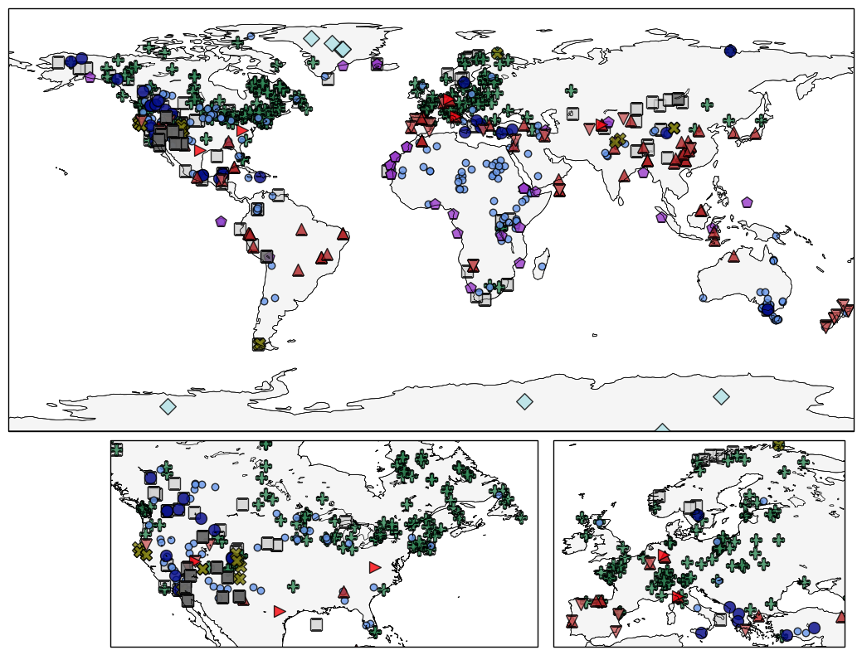
Figure 1: map showing type of proxies/archives
Notes:
Could also symbolize based on source (SISAL/Marsicek Pollen/Lake Level)? Or seasonality? Maybe good for supplementary figures?

Slide 2
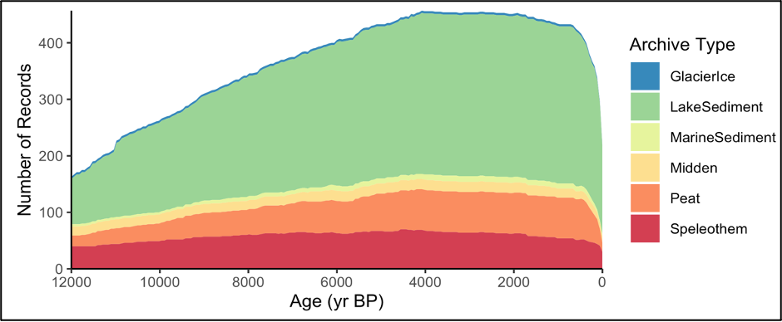
Figure 2: # of records over time
Notes:
Change to be of category

Slide 3
Figure 3: Cluster results
Notes:
R2 values: check from arcgis output

Slide 4
temperature
Notes:
Colors based on HC cluster # so will change to better distinguish neighboring clusters (pacific South America and Antarctica / 2 in Australasia)

Slide 5
Or could use IPCC
Notes:
(Symbol = 6ka-0ka)
Advantages:
don’t change when adding/removing data
Temperature and Hydroclimate regions can be the same
Script can flow smoothly in python without having to switch to device with ArcGIS pro
2) Less arbitrary / no parameters I select
3) translate to other research

Slide 6
Notes:
(Min of 3)

Slide 7
Notes:
(Min of 3)

Slide 8
Notes:
(Min of 3)

Slide 9
Notes:
Comparisons of how proxies (hydroclimate) compare with model pseudoproxies based on various assumptions about proxy climate interpretation (proxy metadata vs all P vs all P-E) and seasonality (proxy metadata vs assume annual are summer vs assume all are summer)
Top: Absolute %
Bottom: Difference between assumption test and using proxy metadata for both assumptions (1st column)

Slide 18
Notes:
Mean value for each timebin. Timeseries standardized over entire Holocene.

